Slide 1
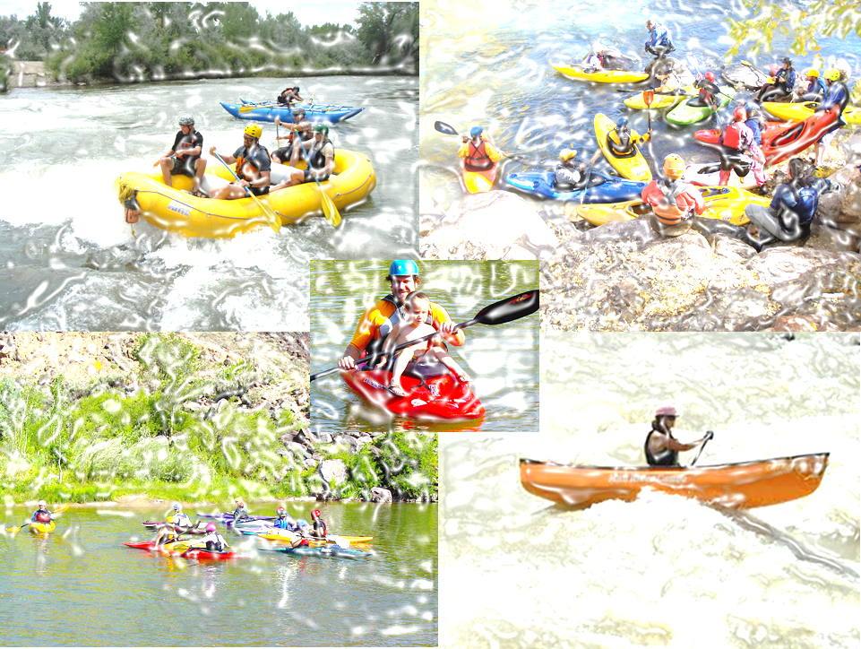
Adobe Whitewater Club of New Mexico
Summer Paddle Sports Clinic and Picnic
When: Saturday August 10, 9:30AM
Where: Taos Junction Bridge Near Pilar NM in the Orilla Verde Recreation Area
Who: Anyone interested in learning to paddle, be part of a strong, passionate and inclusive community or just looking to improve on personal paddling skill
Cost: AWC Members $30.00, Non-members $45.00 (includes annual AWC Membership) All ACA members receive a $5.00 discount.
Camping: Free on Friday and Saturday night at the Taos Junction group campsite.
Clinics offered in:
Beginner , Advance Beginner, Intermediate Whitewater Kayaking- learn to kayak or become a better boater
(Advanced class venue is on the race course section of Rio Grande)
Rafting, learn to paddle raft
Kids clinic (10 and under). Kids are $5.00 or free if ACA members. Must have a Chaperone ($5 or free if ACA member)
Register by contacting Dallas Hill at , The Annual Adobe Club Potluck and Club Meeting will be held on Saturday evening after the clinics conclude. This is a great opportunity to meet Board Members. Please bring something to share.
Information for all interested participants
1) You must be an AWC member to participate 2) For kayak classes you must bring your own boat, paddle, PFD, skirt, helmet, boat flotation and appropriate clothing 3) Bring your own food, water and camping equipment 5) All instructors are ACA certified. Please realize that instructors volunteer for this event and put a fair amount of their own time and money into maintaining their ACA certification for the Love of Rivers and Paddling Education.

