Slide 1
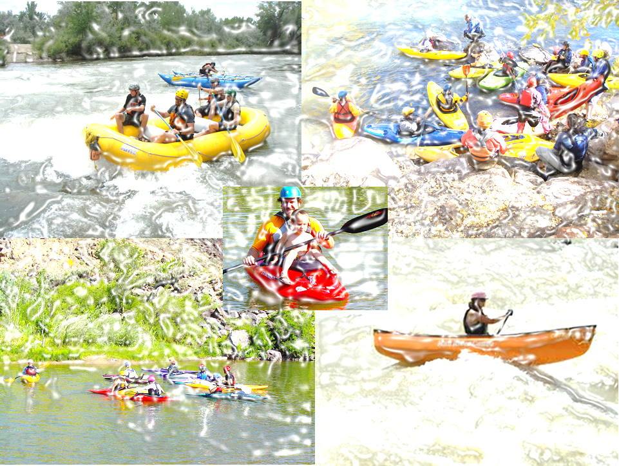
Adobe Whitewater Club of New Mexico
Annual Spring Paddle Sports Clinic
When: Saturday April 5, 9:30AM
Where: Taos Junction Bridge Near Pilar NM in the Orilla Verde Recreation Area
Who: Anyone interested in learning to paddle, be part of a strong, passionate and inclusive community or just looking to improve on personal paddling skill
Cost: AWC Members $30.00, Non-members $45.00 (includes annual AWC Membership) All ACA members receive a $5.00 discount.
Camping: Free on Friday and Saturday night at the Taos Junction group campsite.
Clinics offered in:
* Beginner to advanced whitewater kayaking- learn to kayak or become a better boater
Canoeing– learn how to control a canoe on moving water.
Register by contacting Dallas Hill at jeepster101@comcast.net
Information for all interested participants
1) You must be an AWC member to participate 2) For kayak and canoe classes you must bring your own boat, paddle, PFD, skirt, helmet, boat flotation and appropriate clothing 3) Rafts and paddles are provided for raft classes, students must still bring own PFD, helmet and appropriate clothing 3) Bring your own food, water and camping equipment 5) All instructors are ACA certified. Please realize that instructors volunteer for this event and put a fair amount of their own time and money into maintaining their ACA certification for the Love of Rivers and Paddling Education.

